Slide 1
REQUIREMENT ENGINEERING

Slide 2
Lesson 7: Change Management

Slide 3
Learning Objectives:
By the end of this chapter, students will be able to:
Understand the Fundamentals of Change Management
Describe the Change Management Process
Apply Techniques for Managing Requirement Changes
Understand the Role of Change Control Boards (CCB)
Utilize Tools for Change Management
Manage Requirement Changes in Agile and Traditional Environments

Slide 4
Learning Objectives:
Apply Best Practices for Effective Change Management
Analyze a Real-World Case Study on Change Management

Slide 5
Chapter Outlines
Introduction to Change Management
Change Management Process
Techniques for Managing Requirement Changes
Best Practices in Change Management
Tools for Change Management
Case Study: Change Management in Agile Development

Slide 6
1. Introduction to Change Management
Change management in requirements engineering is the process of handling modifications to requirements systematically. Since software development is dynamic, changes in requirements often arise due to:
New business needs
Evolving stakeholder expectations
Market competition
Technological advancements
A well-defined change management process helps reduce project risks, prevent scope creep, and maintain system integrity.

Slide 7
2. Change Management Process
The process typically follows these steps:
Step 1: Identify Change Requests
Sources of change requests:
Stakeholders (clients, users, developers, etc.)
Regulatory or compliance updates
Market trends
Technological shifts
Tools for tracking changes:
Change request forms
Issue tracking systems (e.g., JIRA, Trello, Redmine)

Slide 8
2. Change Management Process
Step 2: Evaluate Impact
Assess the change in terms of:
Feasibility: Can it be implemented with available resources?
Cost: What will be the financial impact?
Schedule: Will it delay the project?
Risk: Does it introduce new security or compliance risks?
Tools & Techniques:
Impact analysis (e.g., cause-effect diagrams)
Risk assessment matrices
Notes:
Add cause-effect diagram and risk assessment matrices

Slide 9
2. Change Management Process
A Risk Register for an E-Commerce Platform
Notes:
Add cause-effect diagram and risk assessment matrices

Slide 10
Change Request ID | Change Request Description | Likelihood of Failure (1-5) | Impact of Failure (1-5) | Risk Score | CCB Decision / Action
CR-01 | Replace the primary payment gateway | 4 | 5 | 20 | Decline/Postpone: High risk to revenue. Requires a separate sandboxed pilot
CR-02 | Add a dark mode toggle to user settings | 1 | 2 | 2 | Approve: Minimal system impact. Can be assigned directly to junior developers
CR-03 | Migrate session tokens from cookies to local storage | 3 | 4 | 12 | Defer for Review: Medium risk to security. Requires formal security architecture audit.
CR-04 | Rewrite the checkout cart algorithm to support bulk discounts | 3 | 3 | 9 | Approve with Guardrails: Medium risk. Requires strict regression testing.
Notes:
Add cause-effect diagram and risk assessment matrices

Slide 11
IMPACT
Negligible
Minor
Moderate
Critical
Catastrophic
Almost Certain
5 | 10 | 15 | 20 | 25
4 | 8 | 12 | 16 | 20 (CR-01)
3 | 6 | 9 (CR-04) | 12 (CR-03) | 15
2 | 4 | 6 | 8 | 10
1 | 2 (CR-02) | 3 | 4 | 5
Likely
LIKELIHOOD
Moderate
Unlikely
Rare
Notes:
Add cause-effect diagram and risk assessment matrices

Slide 12
2. Change Management Process
Step 3: Approve or Reject Changes
Change Control Board (CCB): A team of stakeholders who decide on changes.
Decision criteria:
Critical vs. Optional changes
Business value and Return on Investment(ROI
Compatibility with system architecture

Slide 13
2. Change Management Process
Step 4: Implement the Change
Update the requirement documents (SRS, backlog, user stories)
Modify design documents and system architecture
Implement changes in code and database

Slide 14
2. Change Management Process
Step 5: Validate and Test
Regression testing to ensure no side effects
User acceptance testing (UAT) for business validation
Step 6: Communicate and Document Changes
Update project documentation
Inform stakeholders about approved changes
Ensure team alignment

Slide 15
3. Techniques for Managing Requirement Changes
Version Control Systems (VCS)
Helps track requirement changes over time.
Tools: Git, SVN
Traceability Matrices
Links each requirement to design, code, and test cases.
Ensures changes are properly tracked.

Slide 16
Req ID | Requirement Description | Design Document | Code Module | Test Case ID | Test Status
BR-01 | System must support secure login via email and password. | SEC-DS-101 (Login Form Architecture) | auth_controller.py | TC-AUTH-01 | Pass
BR-02 | System must lock the user account after 3 failed login attempts. | SEC-DS-102 (Account Lockout Policy) | lockout_service.py | TC-AUTH-02 | Pass
BR-03 | Users must be able to reset their password via an email link. | SEC-DS-103 (Password Reset Flow) | mail_service.py | TC-AUTH-03 | Fail
BR-04 | Password must require at least 1 character number and 1 special character | SEC-DS-104 (Password Complexity) | validation_utils.py | TC-AUTH-04 | Blocked
Notes:
Add cause-effect diagram and risk assessment matrices

Slide 17
3. Techniques for Managing Requirement Changes
Change Prioritization Methods
MoSCoW Method:
Must-have
Should-have
Could-have
Won't-have
Kano Model:
Basic needs
Performance needs
Delighters

Slide 18
3. Techniques for Managing Requirement Changes
Agile Change Management
Use of backlogs for dynamic requirements.
A backlog is a prioritized list of work for the development team derived from the product roadmap and its requirements.
The development team continuously pulls work out of the backlog at a certain rhythm depending on their framework of choice e.g. every iteration in scrum or continually in kanban
Sprint reviews to accommodate changes iteratively.
Agile ceremony where teams present completed work, gather feedback and align with stakeholders.
Agile ceremonies are activities done on a recurring basis in an agile project such as sprint planning, sprint reviews, sprint retrospectives and daily stand-ups. They are not “just” meetings.

Slide 19
4. Best Practices in Change Management
Establish a formal change control process.
Use a requirements repository to track versions.
Keep stakeholders engaged in decision-making.
Apply impact analysis before approving changes.
Implement automation tools to track requirement changes.
Avoid excessive scope changes (scope creep prevention).

Slide 20
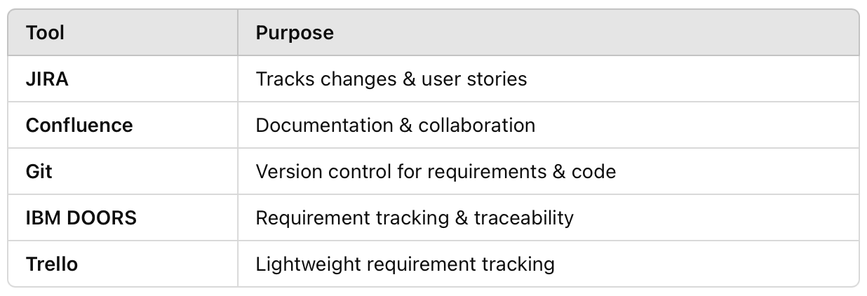
5. Tools for Change Management
Here are some tools commonly used in Change Management:

Slide 21
6. Case Study: Change Management in Agile Development
Scenario:
A fintech startup is developing a mobile banking app. During Sprint 3, a government regulation change requires an additional security verification feature.
How Change Management is Applied:
Change request is logged by the compliance team.
Impact Analysis shows:
Development effort: Medium
Security risk: High
Project timeline: +1 week extension

Slide 22
6. Case Study: Change Management in Agile Development
The Change Control Board approves the change.
Developers implement the feature and update UAT test cases.
The new security feature is deployed, and stakeholders are notified.

Slide 23
References
Atlassian, “What is a Sprint Review in Agile? | Atlassian,” Atlassian, Feb. 11, 2026. https://www.atlassian.com/agile/scrum/sprint-reviews
Atlassian, “What is a Sprint Review in Agile? | Atlassian,” Atlassian, Feb. 11, 2026. https://www.atlassian.com/agile/scrum/sprint-reviews

Slide 24
What Next?
Apply for Junior Business Analyst and Project Manager roles
Look into Human-Computer Interaction (HCI) research.
Do you know you can do your PhD after Undergrad?
Learn tools like Figma, Jira, Trello, Miro
Showcase your work on Linkedin or create a portfolio site

